Slide 1
Initial performance criteria and requirements for innovative and multifunctional building envelope elements
Technology Development

Slide 2
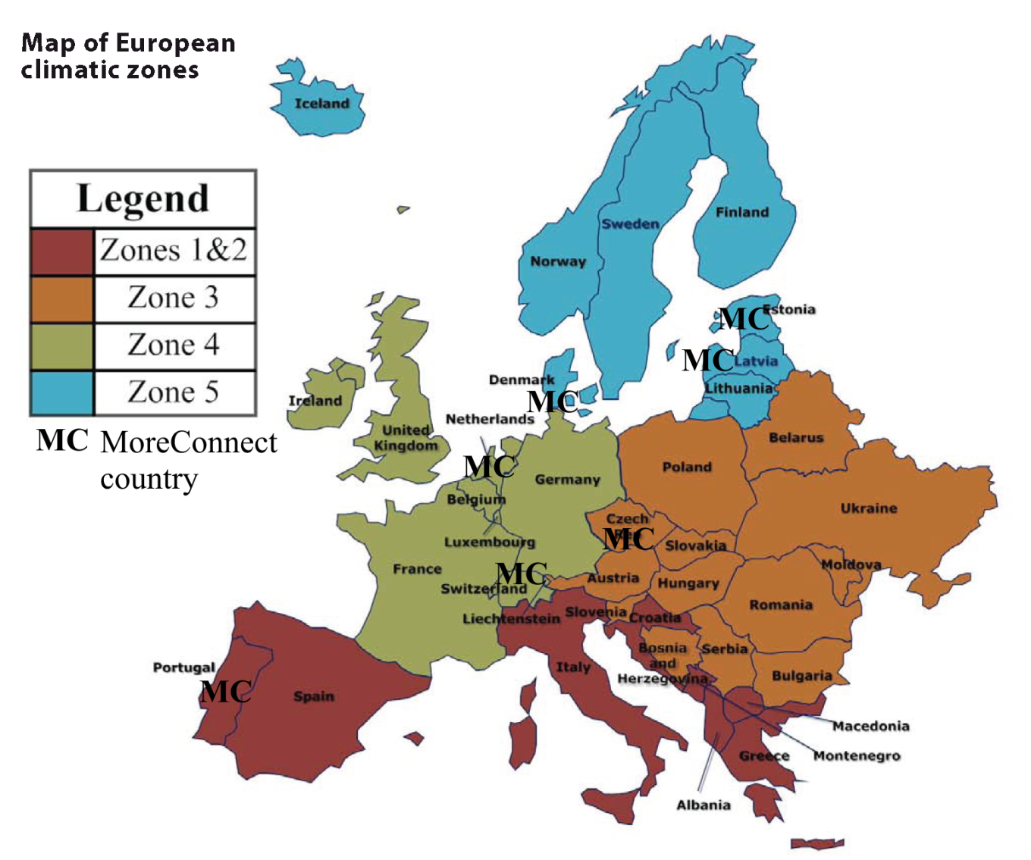
Seven countries for four geo-clusters
Denmark,
Estonia,
Latvia,
Czech Republic,
Portugal,
Netherland,
Switzerland

Slide 3
Table of content
1 Introduction 3
2 Terms and definitions 4
3 Indoor climate 7
4 Energy performance 14
5 The use of resources: economic viability
and cost effectiveness 30
6 References 34

Slide 4
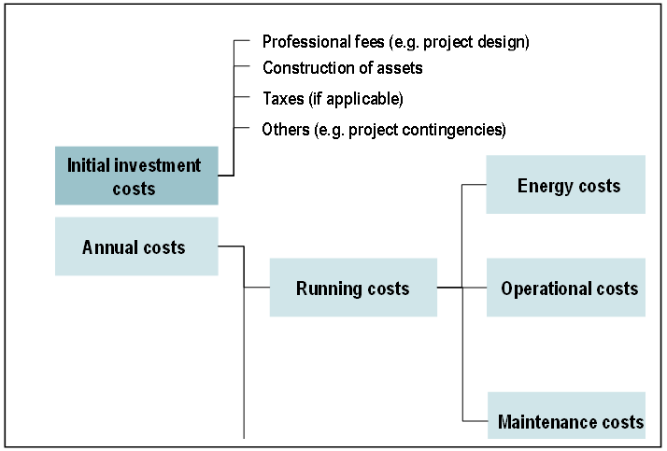
Economic viability and cost effectiveness
Cost categorization

Slide 5
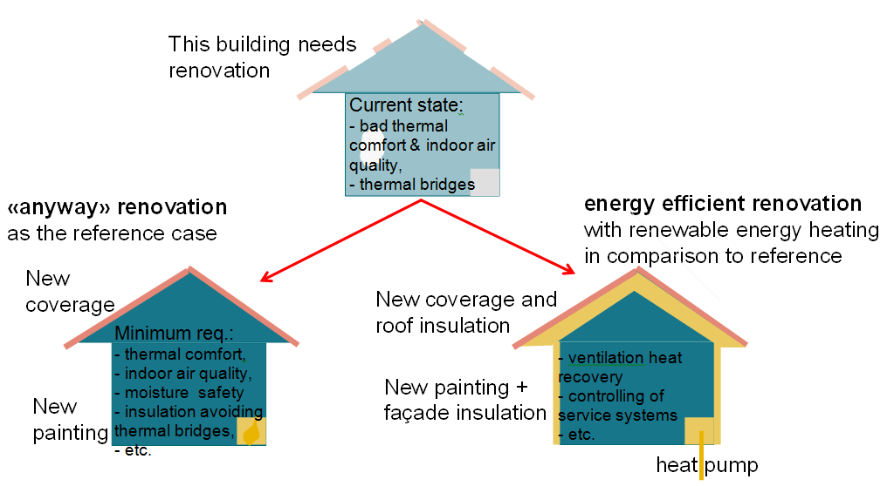
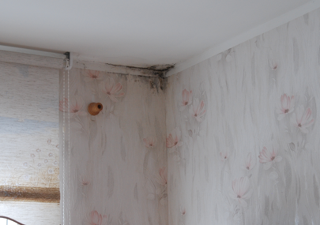
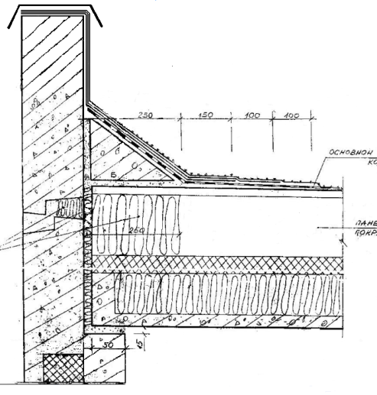
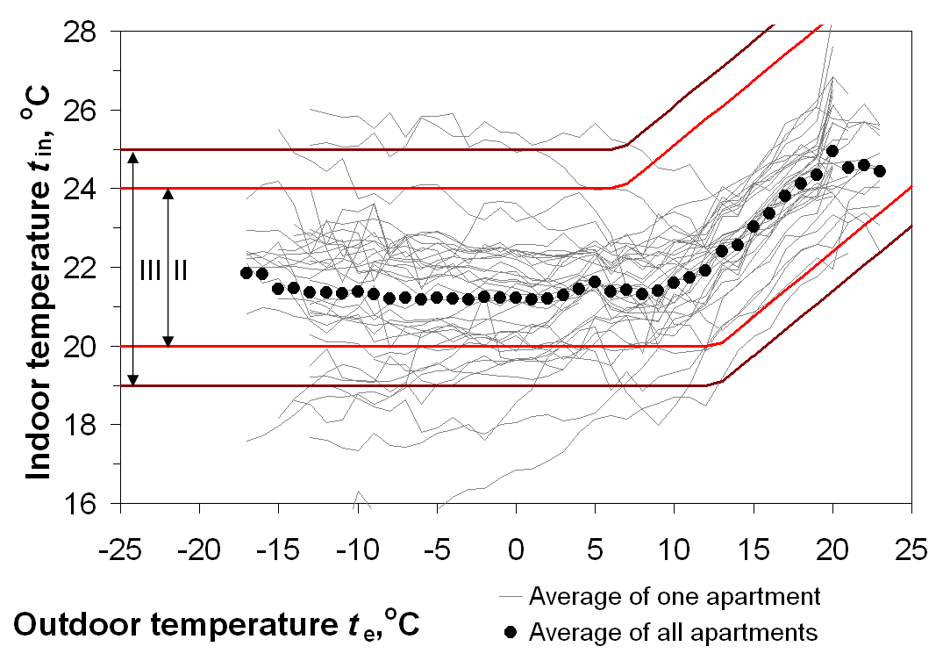
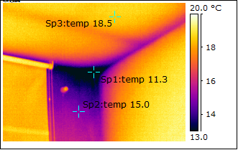
Economic viability and cost effectiveness
Current state of buildings
Minimum requirements for dwellings
Leaking roof
Insufficient ventilation
Damaged facade
Mould
Warm
Cold
Thermal bridges

Slide 6
Economic viability and cost effectiveness
Anyway renovation
Minimum requirements
Energy saving targets
Renovation of ventilation: required vent. airflow;
Control & balancing of heating system;
Durability of facades;
Service life of old HVAC systems;
Additional insulation to avoid thermal bridges
Etc.

Slide 7
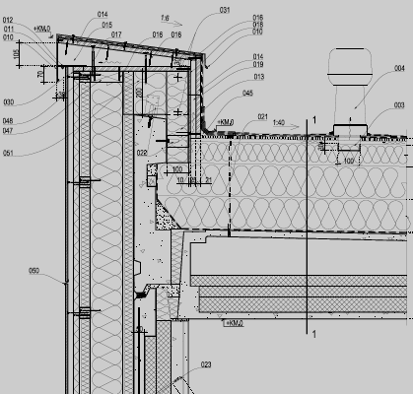
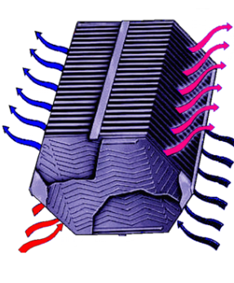
Economic viability and cost effectiveness
Anyway renovation vs. energy related renovation
Minimum requirements Energy saving targets
Thicker insulation
Heat recovery
Renewable energy sources

Slide 8
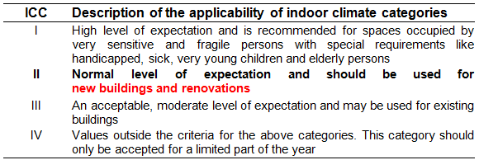
Indoor climate: Indoor climate categories
Energy consumption of buildings depends significantly on the criteria used for:
  the indoor environment (temperature, ventilation and lighting)
  building design (including systems), and
  operation
Indoor climate categories (ICC) (EN 15251)

Slide 9
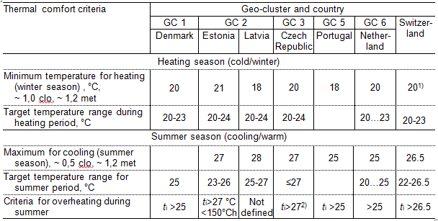
Indoor climate: Thermal comfort
CR 1752; EN ISO 7730
National design values for the indoor temperature for residential buildings in MoreConnect
(mandatory requirements = anyway renovation)

Slide 10
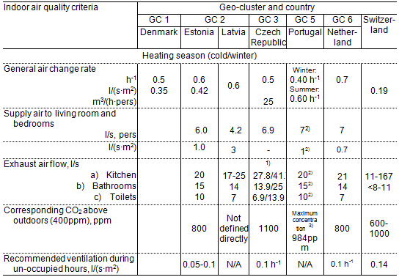
Indoor climate: Indoor air quality
Mandatory requirements = anyway renovation

Slide 11
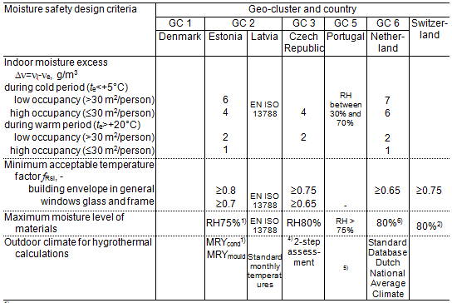
Indoor climate: Moisture safety
EN 15026, EN ISO 13788
Mandatory requirements = anyway renovation
Boundary conditions

Slide 12
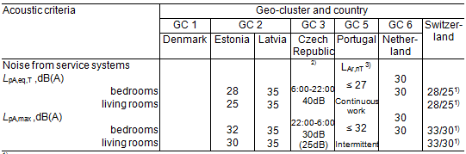
Indoor climate: Acoustics
Acoustic requirements against traffic noise and service systems are important
Additional quality (COST Action TU0901):
Six classes A-F specifying different levels of
acoustic conditions in dwellings.
Class A is the highest class, class F the lowest class

Slide 13
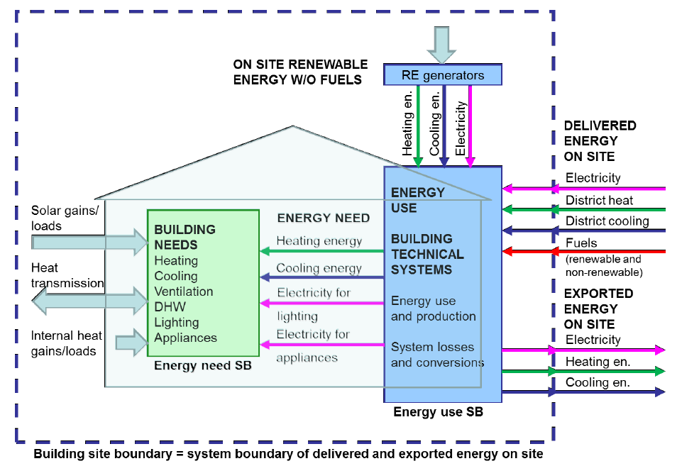
Energy performance of buildings
Energy Performance of Buildings Directive recast (EPBD recast, 2010)

Slide 14
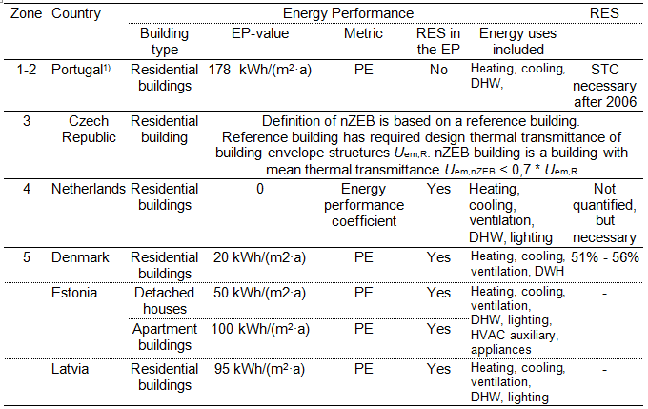
Energy performance of buildings
National examples of nZEB definitions in Europe

Slide 15
Energy related requirements on modular building envelope retrofitting elements
In most of countries the energy performance of buildings is defined as (primary) energy use of whole building’s (heating, cooling, ventilation, DHW, lighting, HVAC auxiliary, appliances), not as specific requirements for building envelope.
For production of modular panels it in necessary to know specific properties of panels (heat loss):
  thermal transmittance U, W/(m²∙K);
  linear thermal transmittance Ψ, W/(m∙K) of connections, details and thermal bridges;
  airtightness q₅₀, m³(h∙m²) of building envelope.

Slide 16
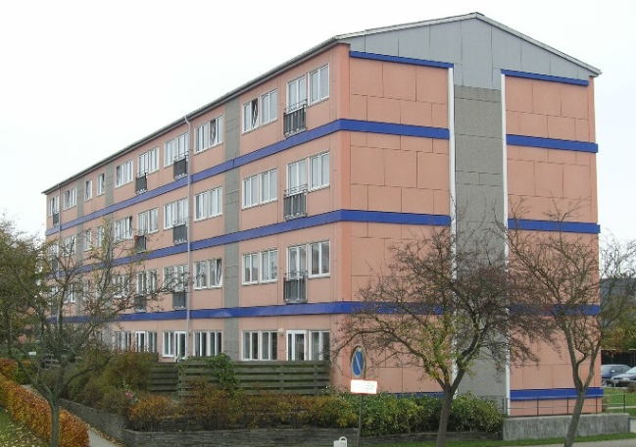
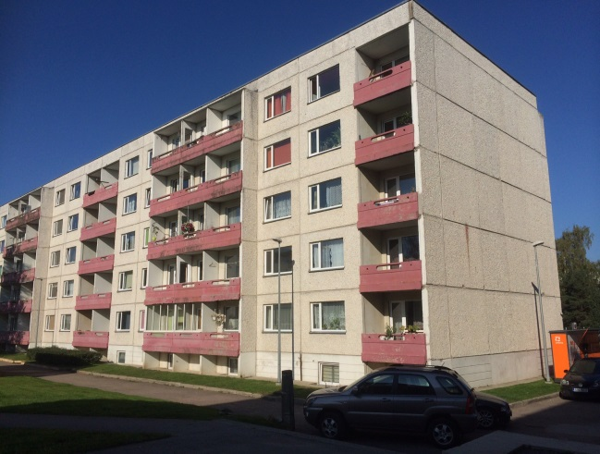
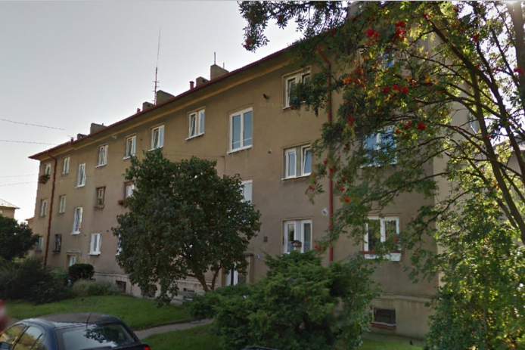
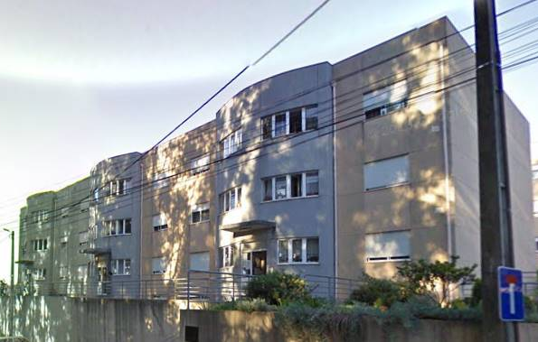
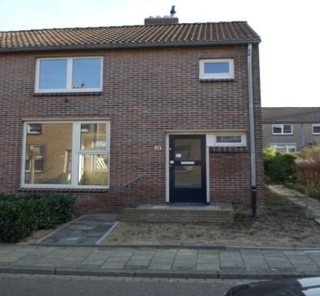
Reference buildings
Typical buildings, structures, and usage
National regulations, local climate
Denmark
Estonia, Latvia
Czech Republic
Portugal
Netherland

Slide 17
Energy related requirements on modular building envelope retrofitting elements
EP targets
  Before the renovation: reference case for base level
  nZEB i.e. national nearly zero energy definition
  (if available in specific country);
  Deep renovation: 80 % reduction of primary energy for:
    space heating (+ pumps);
    space cooling;
    ventilation (heating, cooling, fans);
    domestic hot water (DHW).
  ZEB i.e. Zero Energy Building = the primary energy use = 0 kWh/(m² a) (on annual basis) for:
    space heating (+ pumps);
    space cooling;
    ventilation (heating, cooling, fans);
    domestic hot water.

Slide 18
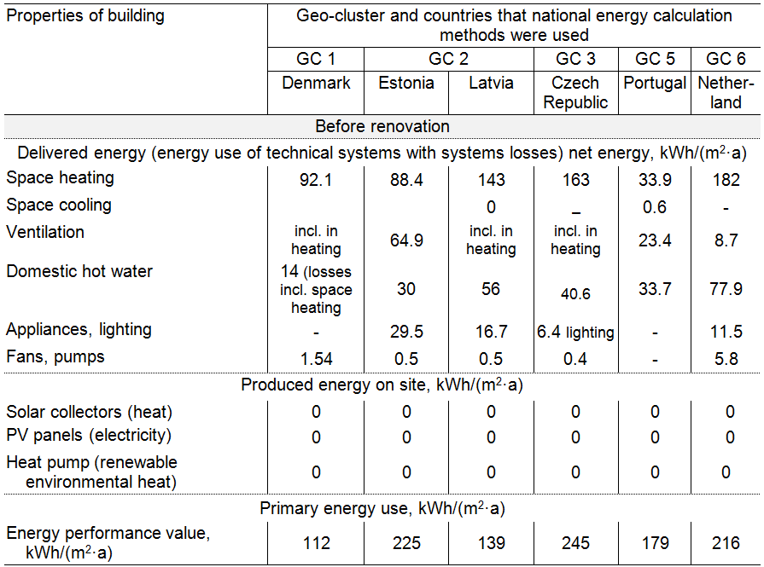
Before the renovation: base level

Slide 19
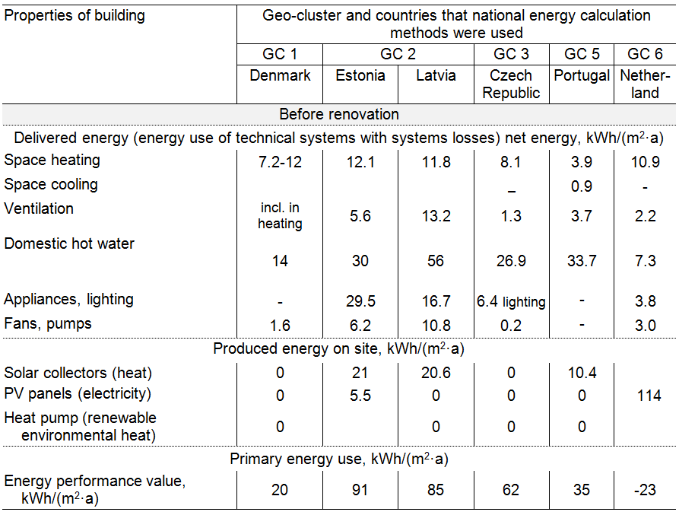
National nZEB: energy usage

Slide 20
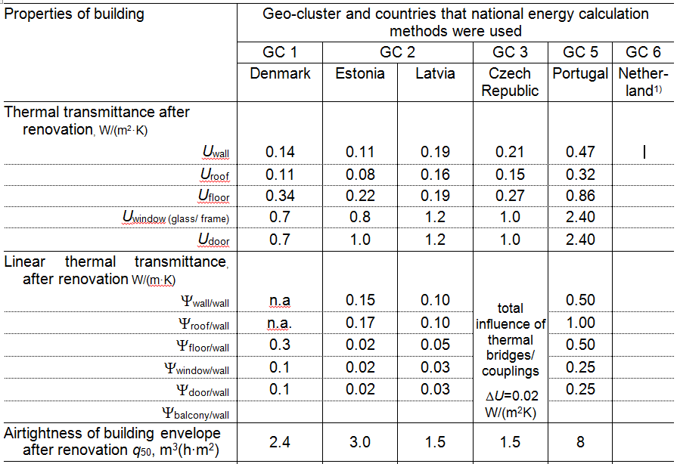
National nZEB: requirements on building envelope

Slide 21
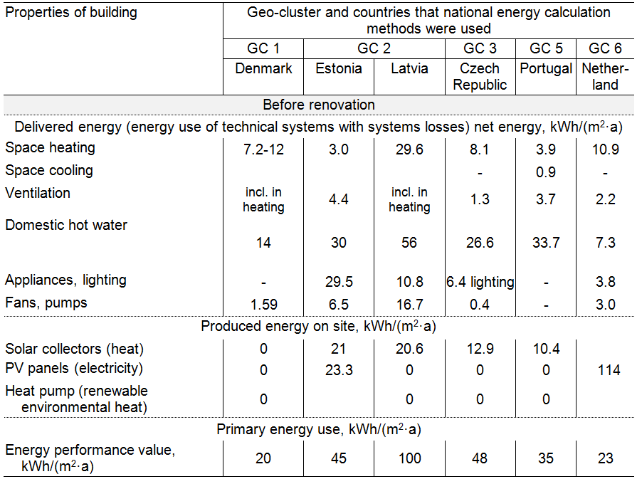
80 % reduction of PE: energy usage

Slide 22
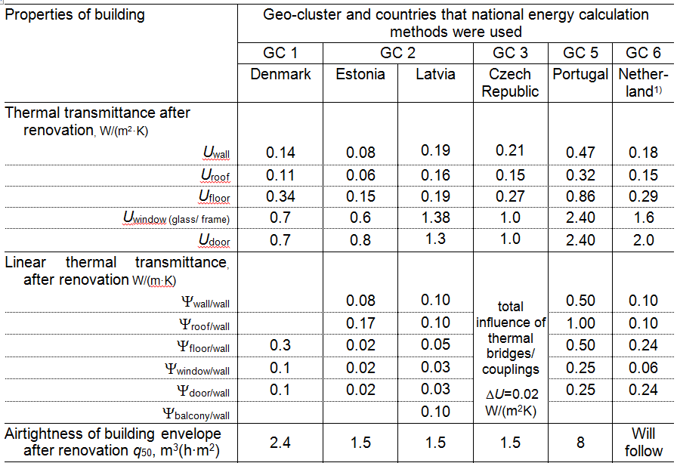
80 % reduction of PE: requirements on building envelope

Slide 23
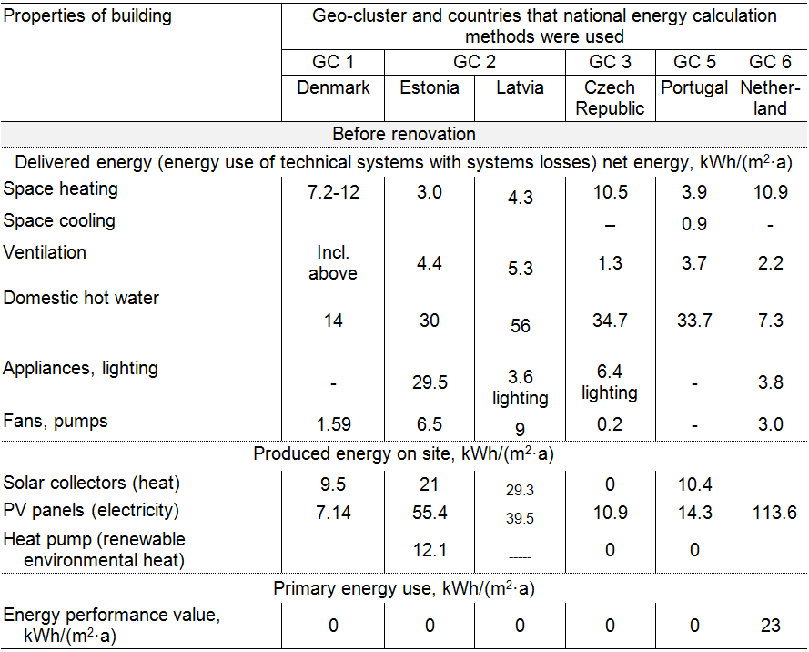
ZEBspace heating and cooling, ventilation, and domestic hot water: energy usage

Slide 24
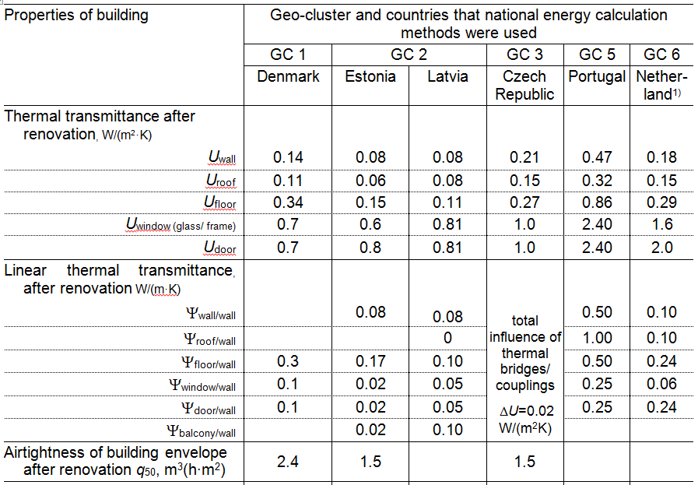
ZEBspace heating and cooling, ventilation, and domestic hot water: requirements on building envelope

Slide 25
How much we can invest in energy savings anyway renovation” measures excluded
Balance between investments and savings
ZEB
nZEB
Cost
Before renovation
Time

Slide 26
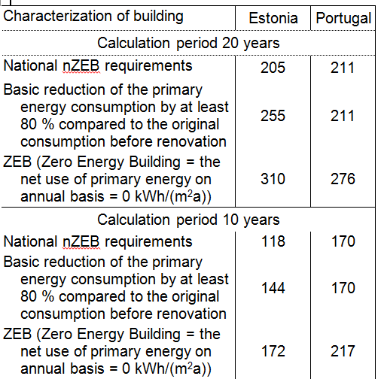

How much we can invest in energy savings anyway renovation” measures excluded
Balance between investments and savings

